Slide 1
Data Science Project on Heart Disease Prediction
Done By:
Mohith Venkata Siva Sashank Namburu

Slide 2
OBJECTIVE: TO PREDICT THE HEART DISEASE USING DATA MINING

Slide 3
INTRODUCTION
Data mining is the process of sorting through large data sets to identify patterns and relationships that can help solve business problems through data analysis. g. Data mining provides a set of tools and techniques that can be applied to this processed data to discover hidden patterns.
Cardiovascular diseases refer to various disorders that can affect the heart and circulatory system. Heart disease has been common for a long time and is still one of the most severe diseases today.
According to WHO, cardiovascular diseases(CVDs) are the number 1 cause of death globally.Four out of 5 CVD deaths are due to heart attacks and strokes, and one-third of these deaths occur prematurely in people under 70 years of age .
Our research can identify people who are more likely tobe diagnosed with heart disease based on their medical history.It predicts based on factors like sugar level, blood pressure, chest pain, cholesterol, etc.

Slide 4
HEART DISEASE PREDICTION INTRODUCTION
Data Mining plays an essential role in predicting the presence/absence of Locomotor disorders, Heart diseases, and more. Such information, if predicted well in advance, can provide important insights to doctors who can then adapt their diagnosis and treatment per a patient basis. Heart disease prediction can be done using various approaches. The primary classification techniques are:
1) Data mining approaches
2)Clustering approaches
The data mining algorithms are used in this work to find heart disease.
The textual data should be preprocessed before being them as input to the data mining algorithms.

Slide 5
DATA MINING TECHNIQUES
The data mining which we used are:
Decision Tree : The decision Tree is the most powerful and popular tool for classification and prediction. A Decision tree is a flowchart-like tree structure, where each internal node denotes a test on an attribute, each branch represents an outcome of the test, and each leaf node (terminal node) holds a class label.
k-means clustering: The k-means clustering algorithm computes the centroids and iterates until it finds the optimal centroid. It assumes that the number of clusters is already known. It is also called a flat clustering algorithm. The number of clusters identified from data by the algorithm is represented by ‘K’ in K-means. In this algorithm, the data points are assigned to a cluster in such a manner that the sum of the squared distance between the data points and the centroid would be minimum. It is to be understood that less variation within the clusters will lead to more similar data points within the same cluster.

Slide 6
Random forests or random decision forests is an ensemble learning method for classification, regression, and other tasks that operates by constructing a multitude of decision trees at training time. For classification tasks, the output of the random forest is the class selected by most trees. For regression tasks, the mean or average prediction of the individual trees is returned. Random decision forests correct for decision trees' habit of overfitting to their training set. Random forests generally outperform decision trees, but their accuracy is lower than gradient-boosted trees. However, data characteristics can affect their performance

Slide 7
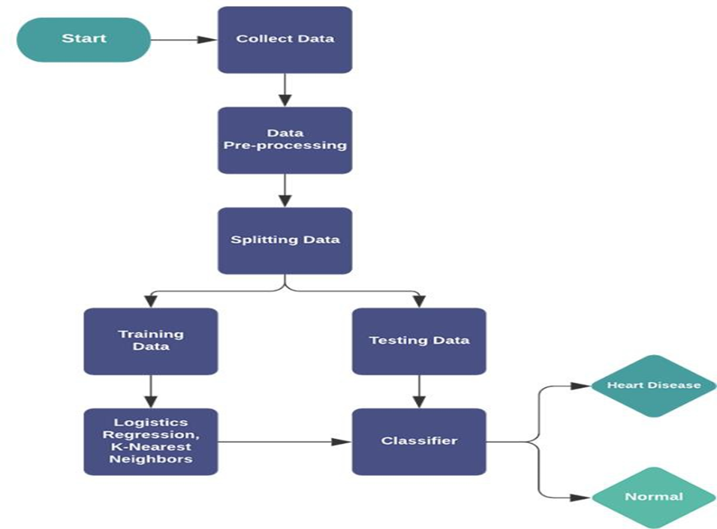
METHODOLOGY

Slide 8
DATA EXTRACTION
Datasets are used for heart disease prediction. The data extracted for the heart disease prediction is taken from Kaggle.com. It was gathered from numerous instances. It provides a thorough detail of people's outlook.
Data Pre-processing
Data preprocessing (DP) techniques were therefore used to prepare data with the goal of improving the performance of heart disease DM based prediction systems.
The DP tasks and techniques most frequently used and the impact of DP tasks and techniques on the performance of classification in cardiology shows the overall performance of classifiers when using DP techniques and comparisons of different combinations classifier-preprocessing in terms of accuracy rate.
The data reduction is the most used preprocessing task in cardiology, followed by data cleaning. In general, preprocessing either maintained or improved the performance of heart disease classifiers

Slide 9
Vectorization
Text cannot be used as an input to data mining algorithms. The algorithms can only analyze numerical data for classification, so the text data are converted to features before passing them as input into predictive modeling algorithms.
The vectorization techniques, count vectorizer , and term frequency-inverse document frequency (TF-IDF) are used. The count vectorizer extracts words from the input text.
Here, the words are considered as features these features are classified by their frequency of use, and they are expressed as a vector containing the frequency of every word in the document.
Training and Testing the Classifiers
The data that are preprocessed and vectorized are passed as input for the data mining algorithms.
Feature scaling is done so that all the features are projected to the 0–1 range. Three algorithms are used for the analysis.

Slide 10
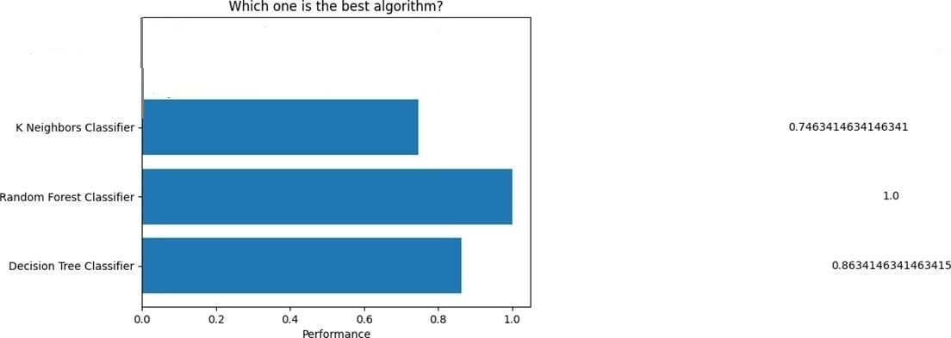
RANKING OF MODELS BASED ON ACCURACY

Slide 11
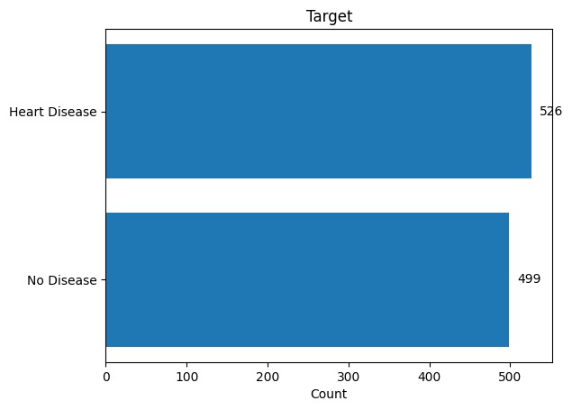
RESULT

Slide 12
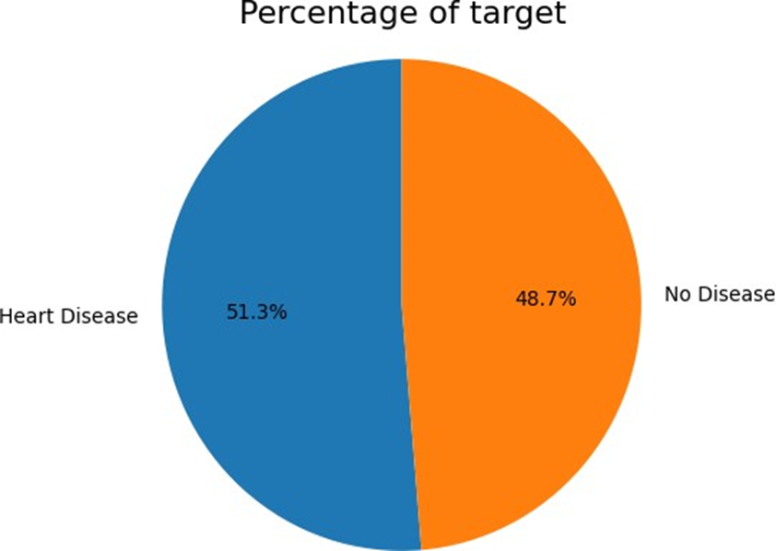
RESULT IN THE FORM OF PERCENTAGE

Slide 13
CONCLUSION
Heart disease prediction is challenging and very important in medical field. However, the mortality rate can be drastically controlled if the disease is detected at an early stage and preventive measures are adopted as soon as possible. The approach has combined the characteristics of the k means clustering decision tree and random forest. In this, we conclude that random forest gives more accurate results in the prediction of heart disease.

Slide 14
REFERENCES
[1] World Health Organization. (n.d.). Cardiovascular diseases. World Health Organization. https://www.who.int/health-topics/cardiovascular-diseases/.
[2] Palaniappan,S.,& Awang, R. (2008). Intelligent heart disease prediction system using data mining techniques. 2008 IEEE/ACS International Conference on Computer Systems and Applications. https://doi.org/10.1109/aiccsa.2008.4493524
[3] Dutta,A., Batabyal,T.Basu ,M., & Acton, S. T. (2020). An efficient convolutional neural network for coronary heart disease prediction. Expert Systems with Applications, 159, 113408. https://doi.org/10.1016/j.eswa.2020.113408
[4] Ronit, R. (2018, June 25). Heart Disease UCI. Kaggle.
https://www.kaggle.com/ronitf/heart-disease-uci
[5] Janosi , A., Detrano , R., Pfisterer , M., & Steinbrunn , W. (1988). UCI Machine Learning Repository: Heart Disease Data Set. https://archive.ics.uci.edu/ml/datasets/Heart+Disease/.

Slide 15
THANK YOU

